Slide 1
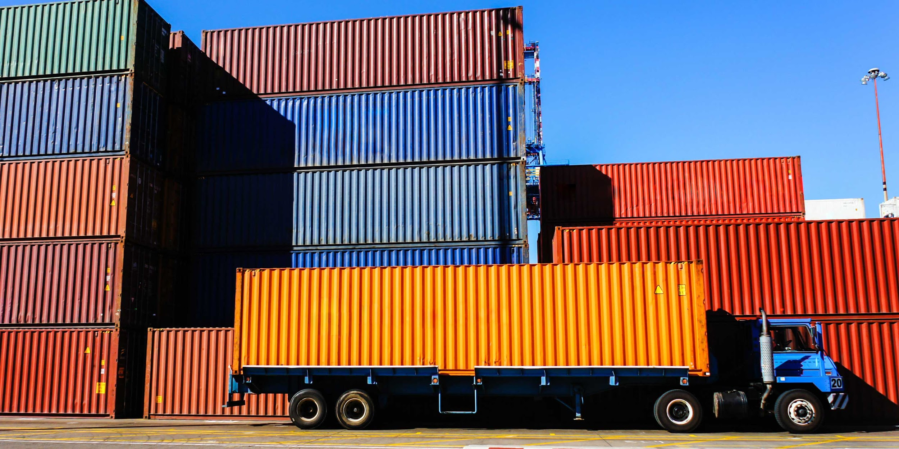
Y3-NUS
Business Analytics Innovation Challenge

Slide 2


Introduction
Jason Yip
Business Analytics
Year 1
Wayne Wee
Philosophy
Year 1

Slide 3

Interpreting the Problem Statement
01
Need for consolidation
02
Costs & time inefficiencies
03
Better optimisation of routes and linkages

Slide 4
Making sense of all
these information
Countries
Required Delivery Date
Cargo Volume
Cargo Value
Shipment Invoices
Cargo Weight
Cities
Location Type
Cargo Type
Custom Costs
Transport Costs
Custom Clearance per Order
Transport Mode
Handling Costs per Ton
Handling Time
Container Size
Travel Time
Custom Processing Time
Tax Rate
Import Tax
Capacity in Volume

Slide 5








Methodology
Data Collection
Data Processing
Optimization
User Interface

Slide 6
Overcoming our Challenges [Data Collection]
Sourcing for reliable information
Hours of data entry..
Ensuring consistency in data

Slide 7
Overcoming our Challenges [Data Processing]
Structuring relational data
Persistent vs Local data storage

Slide 8
Overcoming our Challenges [Optimization]
Speed
Fine-tuning logic to filter routes as much as possible with each iteration
Optimum number of intermediary stations/nodes

Slide 9
Overcoming our Challenges [User Interface]
Reactivity in a single page
Designing a presentable interface which does it’s job
Colour-coding station types and type of paths

Slide 10


Potential Additions
Packing optimization
within containers
Blockchain implementation for real-time updates and transparency on location/price of shipment

Slide 11



Widening the scope
Connecting all international ports
Engine for Real-Time Data

Slide 12
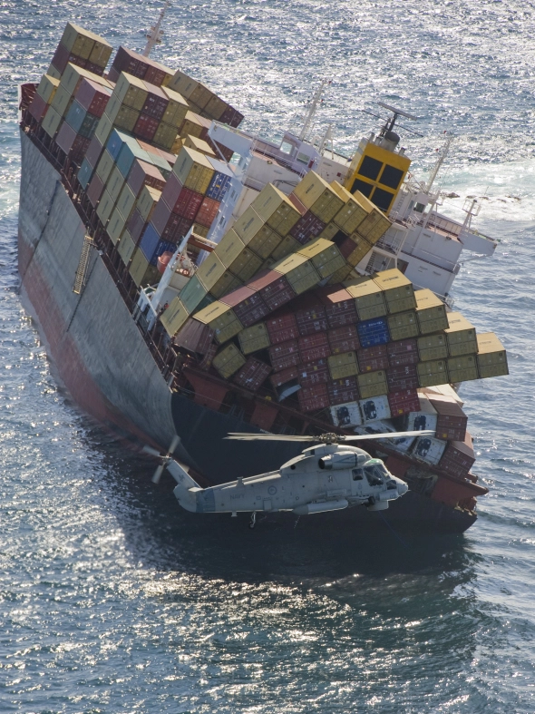
Trying to save as much as you can..?
Notes:
“Don’t bother” “The more you try to squeeze the more risk you risk paying for sunken ships”

Slide 13
Presenting to you…
The Shipping Optimizer

Slide 14



Reducing Inefficiencies
Minimum cost and time not limited by constraints specific to individual transport modes

Slide 15

Dynamic Price Calculation
Price Calculation Algorithm:
Independently decides on type and quantity of container required
Accounts for port and custom costs
Calculates product-specific tax at each node

Slide 16
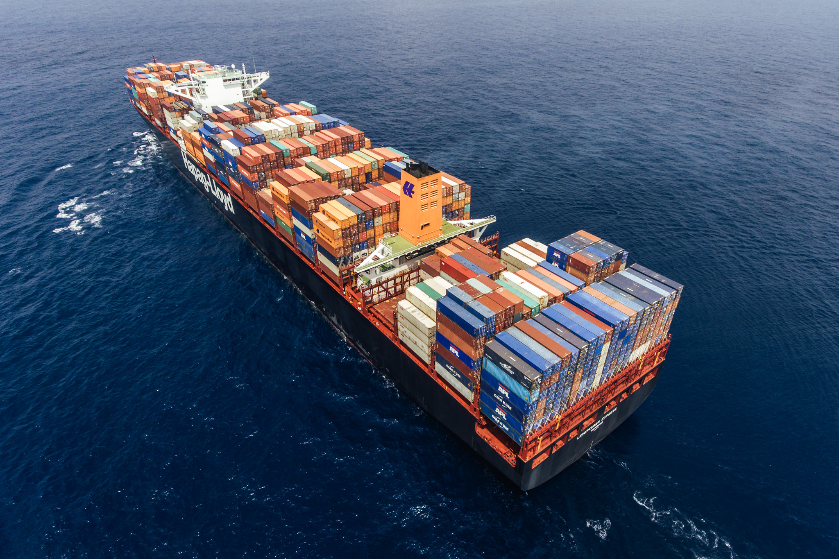
High usability
Simply specify:
Origin and destination
Departure and arrival dates
Cargo weight, volume and value
Type of product
Order quantity

Slide 17
The Shipping Optimizer
(BETA)
http://bit.ly/2G5VrBi

